Slide 1
Chapter Learning Objectives
At the end of this chapter, you will be able to answer the following …
What is frequency domain method in feedback control?
What is frequency response of a linear system?
How is frequency response of a linear system related to its transfer function?
EE3331C/EE3331E Feedback Control Systems
A/Prof. Abdullah Al Mamun, ECE, NUS

Slide 2
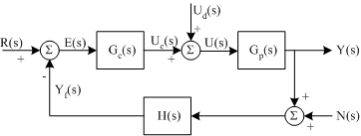
Feedback System: Block Diagram
Block diagram of a typical feedback control system
Y(s): Laplace transform of y(t), the physical variable to be controlled
G_{p}(s): Physical process + Actuation mechanism ⇒ Plant
G_{c}(s): Controller
H(s): Any dynamics involved in the feedback mechanism
N(s): Laplace transform of output disturbance or sensor noise
U(s): Laplace transform of input to the plant
U_{d}(s): Laplace transform of input disturbance
R(s): Laplace transform of reference signal
Everything is given or known except G_{c}(s), which we need to design
EE3331C/EE3331E Feedback Control Systems
A/Prof. Abdullah Al Mamun, ECE, NUS

Slide 3
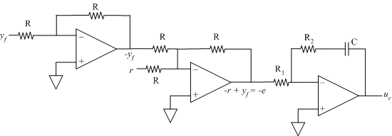
Feedback System: Controller
In most cases, controller is implemented as an electrical system, for example,
An analog circuit involving Op-Amp, resistor, capacitor etc.
A digital circuit involving a processor, DAC, ADC etc.
Controller Implemented using Op-Amp
Feedback signal
Reference
PI Controller Implemented using Op-Amp Circuit
Assuming that we know how to physically realize the controller, the objective in the study of feedback control system is to find the values of controller parameters, e.g., K_{P} and K_{I} for P+I controller
EE3331C/EE3331E Feedback Control Systems
A/Prof. Abdullah Al Mamun, ECE, NUS

Slide 4

Feedback System: Controller
Controller Implemented in a Processor ⇒ Digital Implementation
Analog-to-Digital Converter
Digital-to-Analog Converter
previous_error = 0
integral = 0
start:
error = reference – measured_value
integral = integral + error*dt
derivative = (error – previous error)/dt
output = Kp*error + Ki*integral + Kd*derivative
previous_error = error
wait (dt)
goto start
Pseudocode of a PID controller
Digital controller introduces delay in the feedback system
Delay is equal to the sum of the time required by the processor to compute control signal, conversion time of ADC, and conversion time of DAC
EE3331C/EE3331E Feedback Control Systems
A/Prof. Abdullah Al Mamun, ECE, NUS

Slide 5
Feedback System: Things to Know
Study of feedback system involves
Analysis of closed loop (CL) stability
CL stability is what we are concerned about; open loop may be stable or unstable
Steady-state error analysis
Transient response analysis
Controller design
Performance of feedback system
Laplace Transform based methods -
Stability: Routh-Hurwitz criterion or root locus
Steady-state error (for step, ramp etc): system type and error constant
Transient response: rise time, overshoot, settling time etc. for step input
Controller: three-term controller (P+I+D)
The 2nd-part of EE3331 explores the frequency-domain methods
EE3331C/EE3331E Feedback Control Systems
A/Prof. Abdullah Al Mamun, ECE, NUS

Slide 6
Frequency Response
What is frequency response?
Steady-state response of a linear system subject to sinusoidal input
G(S)
Linear system
You can use Laplace Transform based method to find y_{ss}(t)
Step 1: Take Laplace Transform of u(t) and then find Y(s)
Next step: use partial fraction decomposition
EE3331C/EE3331E Feedback Control Systems
A/Prof. Abdullah Al Mamun, ECE, NUS

Slide 7
Frequency Response
Step 2: Partial Fraction Decomposition of Y(s)
Note: For each individual fraction, the denominator is either a pole of G(s) or a pole of U(s)
Step 3: Take Inverse Laplace Transform of Y(s) expressed as sum of partial fractions in step 2
Poles of G(s) contribute to y_{tr}(t) and poles of U(s) contribute to y_{ss}(t)
Zeros affect the values of k₁, k₂, …. etc.
EE3331C/EE3331E Feedback Control Systems
A/Prof. Abdullah Al Mamun, ECE, NUS

Slide 8
Frequency Response
For stable G(s),
So the steady-state response for sinusoidal input is,
Compare this with
Therefore,
EE3331C/EE3331E Feedback Control Systems
A/Prof. Abdullah Al Mamun, ECE, NUS

Slide 9
Frequency Response
Gain and Phase
G(s)
Steady-state response
Sinusoidal input
Linear system
Conclusion:
For sinusoidal input, the steady-state response of linear system is also sinusoidal
Same frequency (ω) at both input and output
Input and output signals differ in amplitude and phase
Gain of the linear system G(s):
Phase of the linear system G(s):
Both gain and phase vary if frequency ω is varied
M(ω) and φ(ω) define the frequency response of a linear system
EE3331C/EE3331E Feedback Control Systems
A/Prof. Abdullah Al Mamun, ECE, NUS

Slide 10
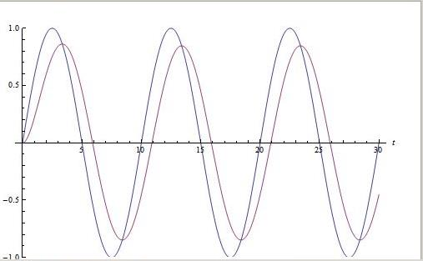
Frequency Response
Measurement
Ch1
G(s)
Linear system
Ch2
To Ch1 of scope or analyzer
To Ch2 of scope or analyzer
Apply Asin(ω_{i}t) as the input to the linear system and allow output to reach its steady-state
Measure gain and phase for frequency ω_{i}
Repeat steps 1 and 2 for all frequencies of interest
In most frequency response analyzers, measurement is automated. Users need to specify the range of frequencies only
EE3331C/EE3331E Feedback Control Systems
A/Prof. Abdullah Al Mamun, ECE, NUS

Slide 11
Frequency Response
Relation between G(s) and its Frequency Response
G(s): Transfer function of a linear system
M(ω_{i}): Gain of that system for frequency ω_{i} rad/s
φ(ω_{i}): Phase of that system for frequency ω_{i} rad/s
Then,
{Refer to the Appendix 1-A for proof}
Example 1-1: Find gain and phase of the following transfer function for ω = 4 rad/s
(A brief review is given in Appendix 1B on basic calculations using complex numbers)
EE3331C/EE3331E Feedback Control Systems
A/Prof. Abdullah Al Mamun, ECE, NUS

Slide 12
Frequency Response
For sinusoidal input, the steady-state output of a linear system G(s) can be found without using the Laplace transform approach
Instead, the gain and phase of G(s) for the frequency of the input sinusoid is used
Example 1-2: Find the output signal in the steady-state of the following transfer function if the input is u(t) = 2sin(2t)
Frequency of the input is ω=2 rad/s. Find gain and phase of G(s) for ω=2.
EE3331C/EE3331E Feedback Control Systems
A/Prof. Abdullah Al Mamun, ECE, NUS

Slide 13
Frequency Response
Frequency Response of Delay
Delay (t_{d})
Element causing delay of t_{d} seconds
Transfer function of the delay element,
Frequency response,
Delay operation does not change the amplitude but the output sine wave is phase shifted by -ωt_{d} rad/s with respect to the input sine wave
EE3331C/EE3331E Feedback Control Systems
A/Prof. Abdullah Al Mamun, ECE, NUS

